Slide 1
Initial Observations workshop
Commerce Commission
12 December 2013

Slide 2
Our brief
We have been asked to consider two questions:
How might the current techniques used by the Commission to forecast EDBs’ costs be improved, for use in a DPP framework, without relying on EDBs’ forecasts?
Are there ways of utilising EDB AMP forecasts to set DPP allowances?
We are investigating approaches that might be useful:
  For the next DPP reset; and
  Over the longer term

Slide 3
Forecasting techniques that do not rely on EDB forecasts
Our approach
Review Commission’s current econometric approach (to opex)
  Testing of alternative modelling techniques (e.g. panel vs. cross-sectional)
  Testing of alternative functional forms
Seek input from EDBs on alternative opex/capex drivers
Review Commission’s 2013 Initial Observations paper
Identify what drivers, if any, should be investigated further
Test new candidate models with new/additional drivers
Mostly complete
Work has just commenced

Slide 4
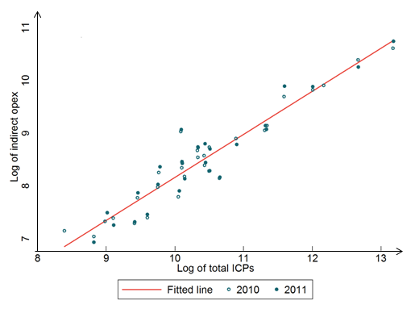
Key findings so far and next steps
Initial findings
The Commission’s opex model performs fairly well
Scale (line length & ICPs) seems to be the most important driver of opex (explains ~ 90% of the variation in the data)
Estimated elasticities differ for small and large networks
Modelling the time dimension (even with a few additional years of data) will not change the Commission’s results materially
Customer connections vs. indirect opex
Improvements may be possible
EDBs have told us that the following additional drivers could be important:
  Asset age/remaining expected life
  Network characteristics (e.g. rural vs. urban, underground vs. overhead)
How are major anticipated ‘step changes’ in expenditure to be taken account of?
Next steps:
Check robustness of data available
Test alternative opex models with additional drivers / EDB subsamples
Investigate if a similar model may be built to forecast capex

Slide 5
Options for making greater use of EDB forecasts
Text
Txt
Text
Txt
Options constrained by high-level DPP framework
Text
Txt
Detailed evaluation of forecasts – conventionally used in Great Britain and Australia
  Detailed evaluation of entire forecast not feasible under DPP
  But could have regard to EDB forecasts wrt discrete ‘step changes’ if well-justified
Compare track records of different EDBs’ AMPs against actuals over multiple years and put weight on those that have tended to be most consistently accurate – But:
  Need to account for EDBs’ awareness that their forecasts would be used to set revenue
  No guarantee that actual expenditure reflects efficient levels
Prioritised treatment / rewards (akin to Ofgem’s ‘fast track’) for well-justified expenditure plans
  But such ‘twin tracking’ seems incompatible with the DPP/optional CPP process
Incremental Rolling Incentive Scheme (IRIS) – would help ensure more equal incentive factors, which would reduce incentives to inflate base year expenditure
  But will not itself improve the reliability of EDB forecasts
Menu regulation – based on Ofgem’s (and Ofwat’s) Information Quality Incentive (IQI) mechanism
Text
Txt
Text
Txt
Text
Txt
Text
Txt
Text
Txt

Slide 6
Menu regulation – IQI
Text
Txt
Text
Txt
Key idea
Regulated businesses are profit-maximisers and will respond to incentives
Companies are offered a menu of payoffs that depend on:
  Accuracy of forecasts – A company is always best off submitting accurate forecasts
  Efficiency – Once forecasts are submitted, a company is always better off if it can beat its forecast
Possible applications in NZ
An IQI mechanism seems a very promising way to address the Commission’s concerns about relying on EDB forecasts
  There is empirical evidence from Great Britain that IQI has altered companies’ behaviour
  Is relatively low cost to run so would fit within a DPP framework
Requires time for companies to adjust their behaviour
  We think a ‘shadow run’ of the IQI at the next price reset would be useful (with aim of full implementation by 2020)
  Interim options for using EDB forecasts might be possible for the next reset
Text
Txt
Text
Txt
Text
Txt
Text
Txt
Text
Txt
Text
Txt

Slide 7

Frontier Economics Pty Ltd in Australia is a member of the Frontier Economics network, which consists of separate companies based in Australia (Brisbane, Melbourne & Sydney) and Europe (Brussels, Cologne, London and Madrid). The companies are independently owned, and legal commitments entered into by any one company do not impose any obligations on other companies in the network. All views expressed in this document are the views of Frontier Economics Pty Ltd.

Slide 8
FRONTIER ECONOMICS PTY. LTD.
MELBOURNE | SYDNEY
Frontier Economics Pty Ltd, 395 Collins Street, Melbourne, Vic 3000
Tel. +61 (0)3 9620 4488 Fax. +61 (0)3 9620 4499 www.frontier-economics.com

