Slide 1
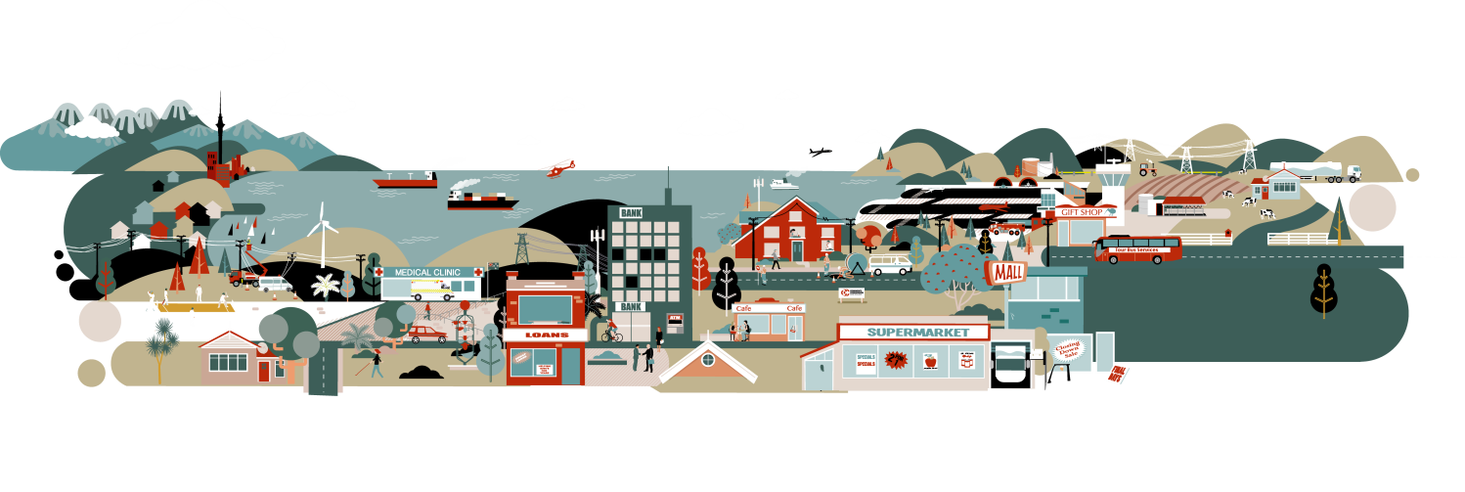
Identifying drivers of expenditure

Slide 2

Reasons for spending money
Effective regulation requires an understanding of why a business spends money
Many different ways to categorise expenditure.
To help with understanding, the initial observation paper provides a high-level framework for thinking about expenditure undertaken by electricity distributors
The thinking builds on work previously undertaken when ID requirements were being developed in 2011

Slide 3
The framework is built around 3 high-level drivers of expenditure
Ownership – Owning an asset results in obligations which require expenditure
Health – Maintaining asset health requires expenditure
Capacity – Maintaining sufficient capacity requires expenditure

Slide 4
Examples of specific expenditure associated with each high level driver
Ownership
Routine maintenance
Ensuring sufficient health
Capacity
Changing requirements of consumers
Vegetation management
Compliance with any laws and regulations
Health
Maintenance of old assets
Replacement of old assets
Random interruptions (eg, storms)
Total demand
Locational demand
New connections

Slide 5
Additional factors can also affect the amount of expenditure
The most important additional factors are:
Variation in expenditure relative to other distributors (Network characteristics)
Evolution of the operating environment over time (Time changes)
      Both step-changes and movements in trends
      Internal and external factors

Slide 6
Examples of network characteristics and time factors
Network characteristics
Network design/topology
Network topography
Consumer types (rural vs. urban, etc.)
Changes in input prices
Changes in company attitude to risk
Changes in target level of quality
Changes in laws and regulations
Time changes

Slide 7
High-level framework
Network characteristics
Time changes
1
Ownership
Network Expenditure
2
Health
3
Capacity

Slide 8
Questions
Are the concepts fully understood?
Does the framework provide a good structure for discussing expenditure?
Is there anything missing from the framework that should be included?

Slide 9
The majority of operating expenditure is a result of the Ownership driver

Slide 10
Capital expenditure is affected by all three high-level drivers

Slide 11
Using proxies to represent the high-level drivers
Awareness of high level drivers enables us to understand expenditure forecasts
Broadly,
  High numbers of assets (Ownership) → Higher expenditure
  High asset health requirements (Health) → Higher expenditure
  Significantly increasing demand (Capacity)→ Higher expenditure
However determining the level of ‘ownership’, ‘health’ and ‘capacity’ for an individual network is difficult
Proxies are therefore needed to represent these high-level drivers from the data available in the information disclosures

Slide 12
Broadly, Ownership can be represented by measures of network scale
Number of ways through which scale can be assessed
Monetary or non-monetary /physical values?
Determine empirically
Potential Ownership Proxy | ID schedule
Total energy delivered in 2013 | Schedule 12(c)
Maximum coincident system demand in 2013 | Schedule 12(c)
Distribution transformer capacity (distributor owned) | Schedule 12(b)
Number of assets (by asset category) | Schedule 9(a)
Total circuit length | Schedule 9(c)
Total opening RAB value | Schedule 4
Number of connections in disclosure year | Schedule 8

Slide 13
The Health of an asset is a wide-ranging concept
Suitable measures could be indications of asset health (eg, condition, age) or outcomes (quality standards)
Operating environment is important
Need to consider that condition is self-determined in ID
Potential Health Proxy | ID schedule
Asset condition at start of planning period | Schedule 12(a)
Percentage of assets forecast to be replaced in the next 5 years | Schedule 12(a)
Forecast SAIDI and SAIFI by class B and C | Schedule 12(d)
Asset Age profile | Schedule 9(b)
Actual 2013 values for SAIDI and SAIFI by class B and C | Schedule 10

Slide 14
Capacity is most closely linked to changing consumer demand
Affected by increasing total volume, peak, location effects and additional connections
Network ‘Headroom’ (ie, low current utilisation) suggests potential for demand growth without significant expenditure
Capacity-driven expenditure reflects changes in demand rather than absolute levels
Potential Capacity Proxy | ID schedule
Number of forecast consumer connections | Schedule 12(c)
Forecast total energy delivered to ICPs | Schedule 12(c)
Forecast maximum coincident system demand | Schedule 12(c)
Current utilisation of installed firm capacity (by zone substation) | Schedule 12(b)
Expected utilisation of installed firm capacity in five years (by zone substation) | Schedule 12(a)

Slide 15
Other options for proxies/measures?
Ownership
  Modern Equivalent Asset Value (MEAV); and
  Non-network measures, like regional GDP or regional population
Health
  Condition Based Risk Management (CBRM)
Capacity
  Independent forecasts of demand growth; and
  Related non-network metrics.

Slide 16
Summary
The high-level framework with the three drivers of Ownership, Health and Capacity provides a clear way of thinking about distributor expenditure
Data from ID provides an opportunity to identify these high-level drivers and use in a comparison against relevant expenditure categories
Work still to be done in terms of choosing the most appropriate measures to represent high-level drivers

Slide 17


