Slide 1
Initial observations on the Initial Observations
Nathan Strong
Chair, ENA Default Price Path Working Group

Slide 2
Overview
The ENA has established a working group to examine possible approaches to forecasting key components that could potentially be used in the DPP reset
  Including capex, opex and input prices
  Short-term: what is feasible for the next reset, given existing data?
  Long-term: what might be used in future resets, with longer time to develop models and acquire data?
Part of the analysis is considering similar issues to that raised in the Commission’s Initial Observations on 2013 AMPs
This presentation covers some general and specific initial reactions to the Commission’s paper

Slide 3
General comments
From the industry’s perspective the paper provides a useful mirror back to the industry providing a view of the wide variations in future expenditure plans
Information sharing between EDBs tends to be more focussed on particular issues rather than an aggregated view
Compilation of the accompanying database is useful and has enabled companies to start undertaking their own analysis
Highlights that potentially there are some categorisation/ definitional issues that may need to be addressed to ensure that the right, or meaningful data is captured
Paper provides some useful context for further discussions with stakeholders, including the Commission, about the sources of significant variation across EDBs in their plans and how we can explain expenditure plans in the context of underlying drivers

Slide 4
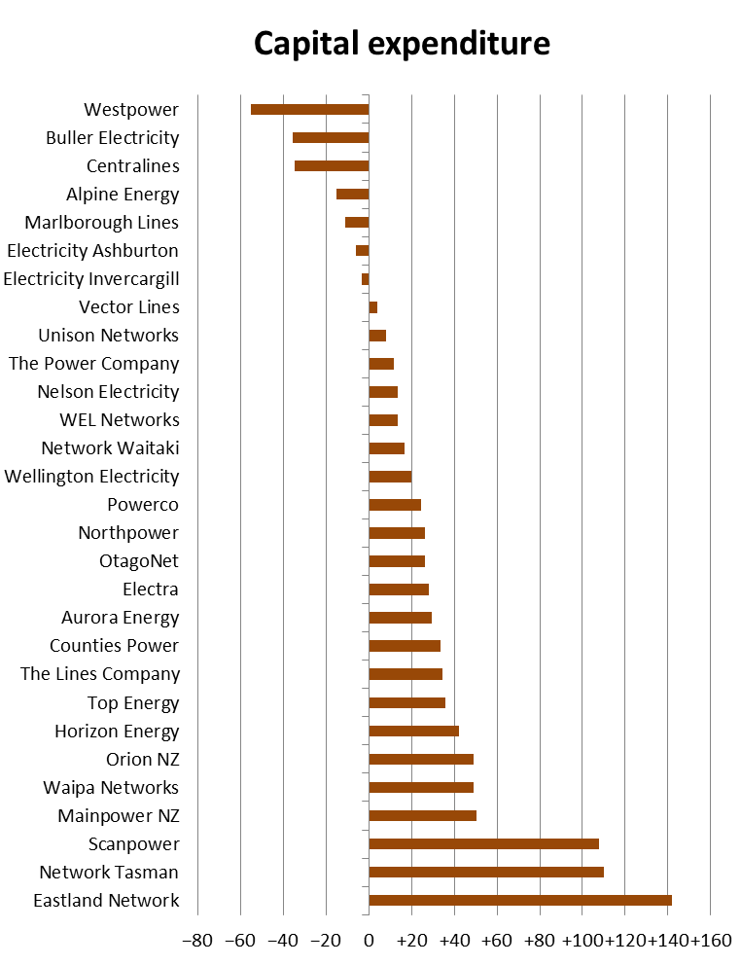
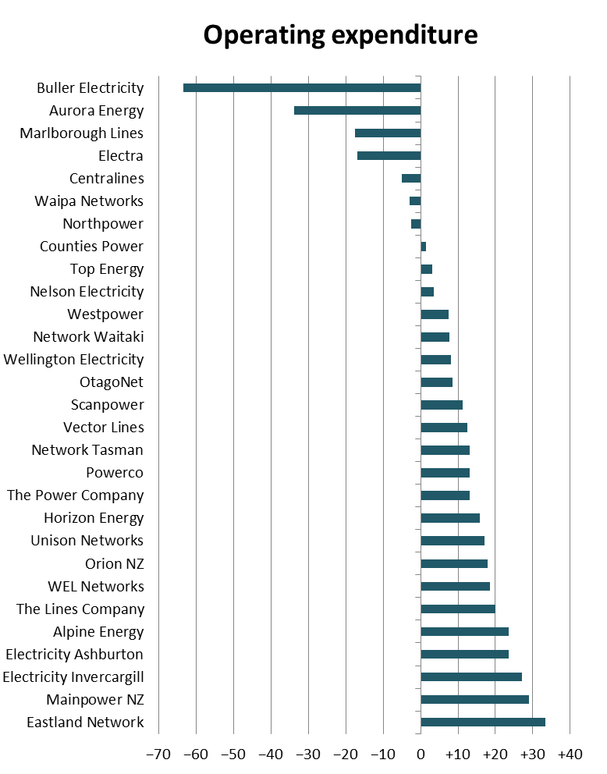
Significant variation in plans
Initial observations suggest significant variation in expenditure plans across EDBs is likely

Slide 5
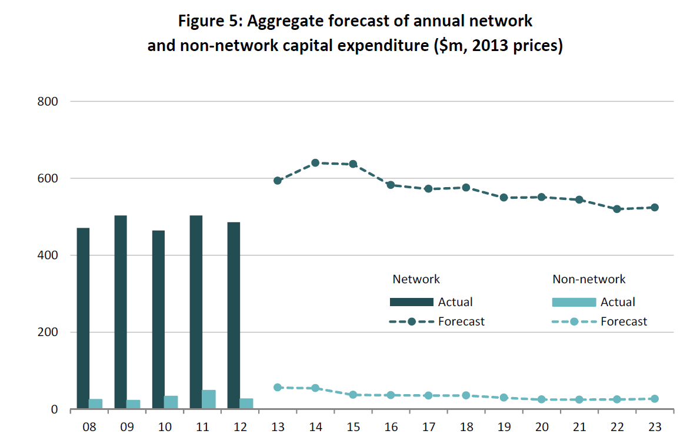
Step up in capex envisaged
EDBs continue to forecast a significant step up in capex, driven by replacement and renewal expenditure requirements

Slide 6
Issues that arise
How can accurate models be developed that seek to explain the variation across EDBs in both capex and opex plans?
  How much can be explained using high-level models?
  In the context of the DPP reset, what do we do with the expenditure categories that are difficult to explain?
Will the uplift in replacement and renewal expenditure arrive and why does it keep getting pushed out?

Slide 7
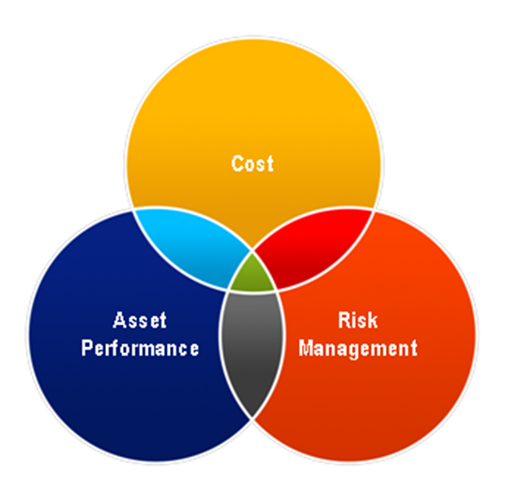
Explanatory factors
The Commission’s key drivers analysis correctly identify at a high level the categories of factors that drive expenditure
  Ownership, health and capacity
But how EDBs make asset management decisions in the context of those high level drivers in turn is driven by a large number of factors, e.g.,
  Risk appetite
  Organisational capability and resources,
  including data, knowledge
  Views of the future, customer preferences
  Attitudes to technology and innovation
  Changes in regulation and legislation
Likely to be difficult to account for
these factors in high-level model

Slide 8
Explanatory factors cont
The step increase in replacement and renewal capex must inevitably come through, as aged assets cannot be maintained indefinitely
  Part of explanation for shifting timing of increased expenditure likely to be organisational capacity to ramp up expenditure levels
  Potentially a factor for industry to consider is improved consideration of resourcing and resource risks to the achievement of AMP forecasts

Slide 9
Challenges
For the DPP reset, further work to do
  Need to test further models especially those exploring asset health related drivers
  If high-level models cannot be developed to accurately forecast capex and opex, what are the alternatives?
  This is being considered by ENA’s DPP forecasting working group, but Commission also needs to consider these wider issues in the context of what the DPP/CPP environment permits

Slide 10
Other observations
Capital contributions need to be considered when looking at expenditure
  Customer capex can be difficult to predict and has priority when it arrives
  Contributions are netted from commissioned assets so large contributions can be mistaken for falls in capex
Industry is finding it useful not to have to prepare full AMP disclosures for 2014, allowing more time to focus on the Schedules

